Slide 1

Capstone:Single Nucleotide Polymorphisms (SNPs) and Overlapping G4-Quadruplex Sequences (G4s)
By: Marc Shebaby

Slide 2
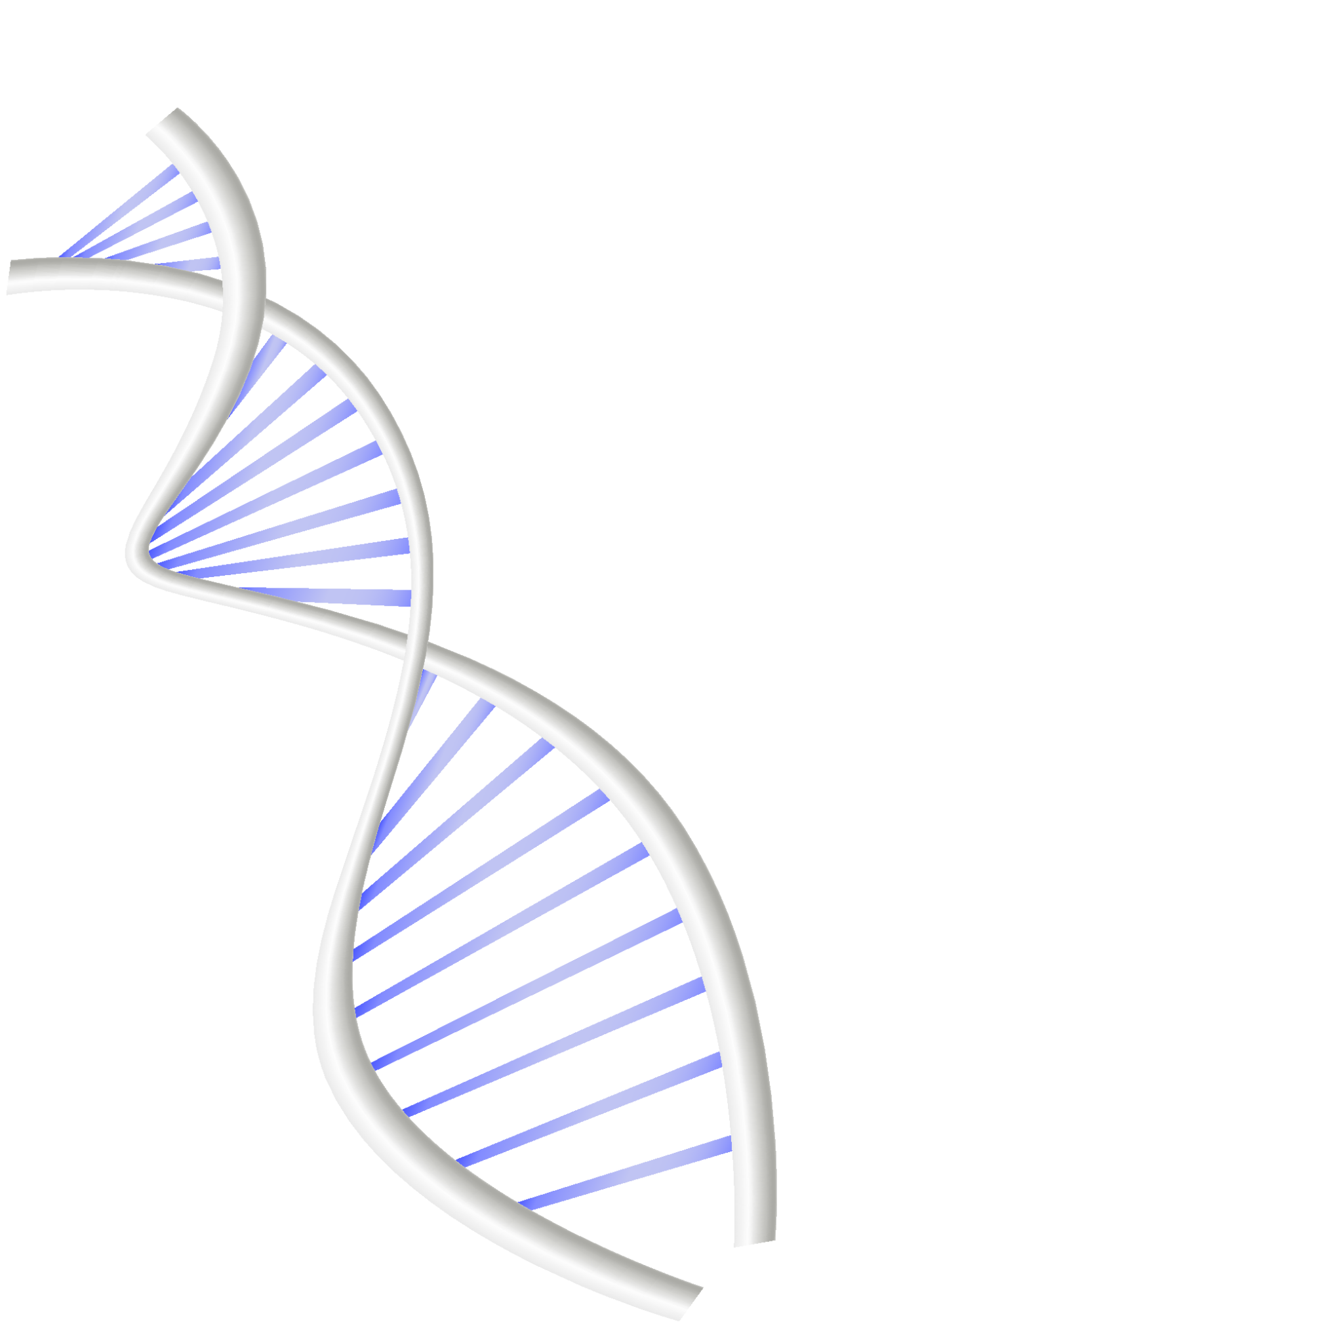
Outline
Milestones
What are G4 quadruplexes?
What are some of its functional implications?
How to detect them by G4Hunter Tool.
How could the new code I wrote be beneficial.

Slide 3
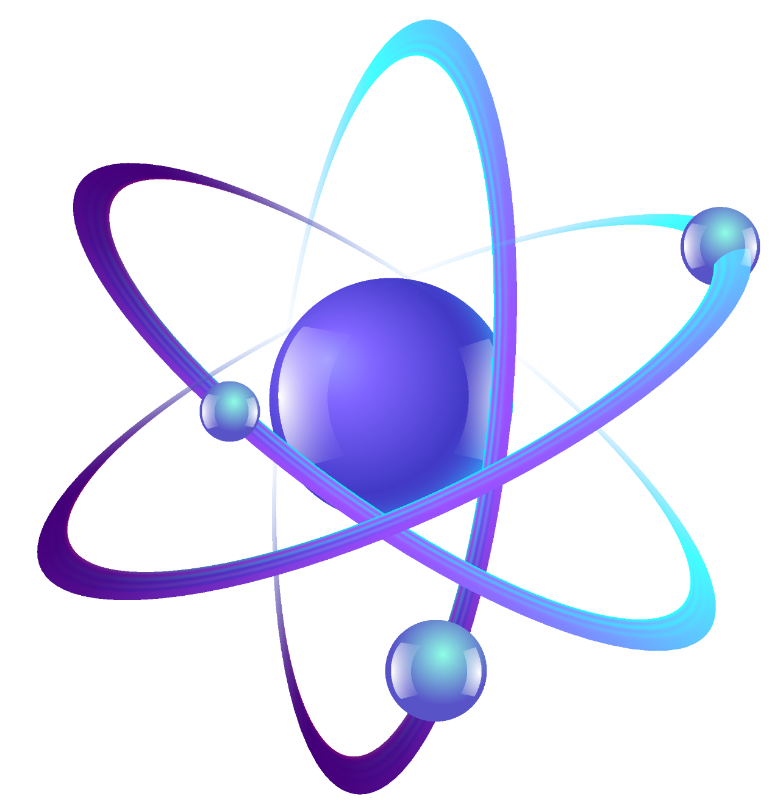
Milestones So Far
01
In vitro Studies
03
Genome-wide identification
02
Functional Implications

Slide 4


In Vitro Studies
Discovered in studies that revealed DNA folding in vitro.
Each guanine base interacts with the neighboring guanines through Hoogsteen hydrogen bonding, and forms a stable tetrad structure called G4 quadruplex.
DNA that developed G4 quadruplexes in their secondary structures possess high Guanine bases relative to other nucleotides.

Slide 5
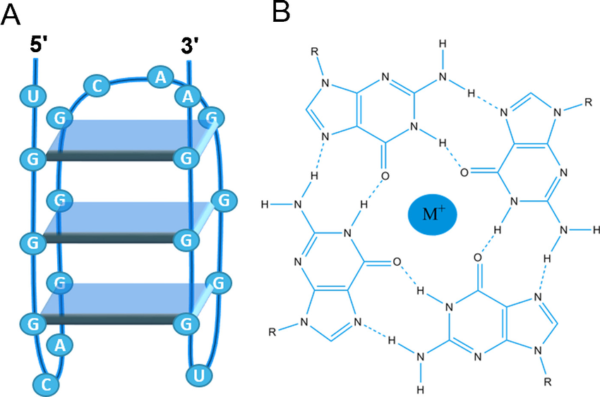
G4 Quadruplex Structure
The G-tetrads stack on top of each other

Slide 6
Functional Implications
DNA repair system
DNA replication
Telomere maintenance
G4-Quadruplexes are associated with several molecular implications:
DNA transcription
Cancer
Gene expression

Slide 7
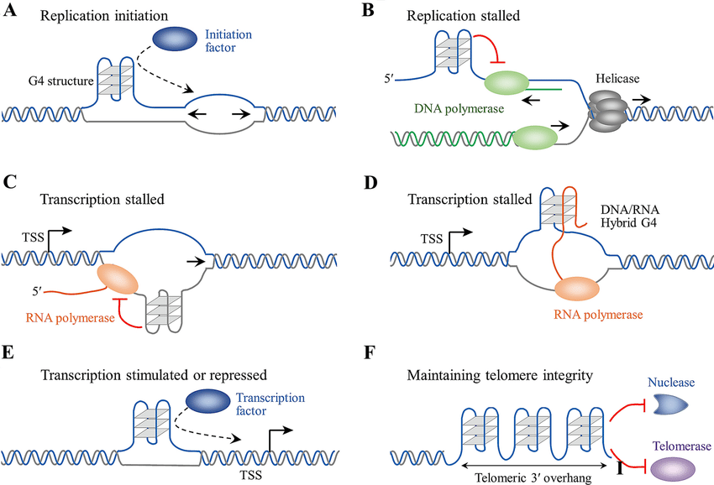

Various mechanisms of G4-quadruplexes

Slide 8
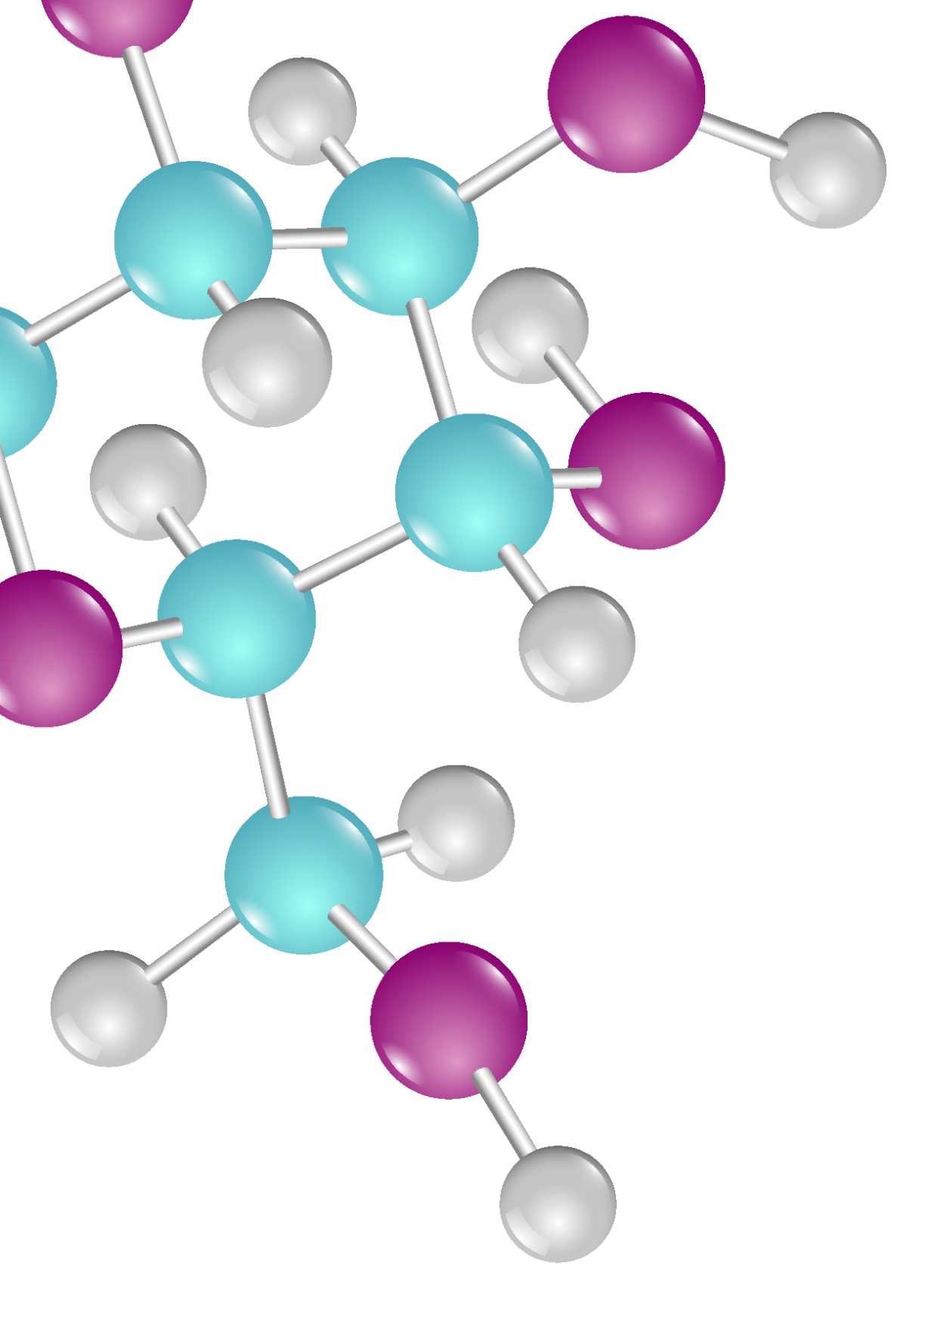
SNPs
Single nucleotide polymorphisms (SNPs) are genetic variations that arise within DNA sequences.
Can be linked to various diseases.
According to the latest studies, SNPs could be associated with G4-quadruplex structures and impact gene regulation.

Slide 9

SNPs and G4 Quadruplex in Cancer
One study led to two crucial observations
TAOK21
CXCL14
SNPs that overlapped a predicted RNA G4 lead to its destabilization and consequently result in the upregulation of the CXCL14 gene expression.
Another observation involved the stabilization of a predicted RNA G4 by overlapping SNPs and the downregulation of the TAOK21 gene expression.

Slide 10

Genome-wide identification
Recent literature has been trying to explore the functionality of G4 –quadruplexes by relying on bioinformatics tools to detect possible G4 sequences in genes.
The most prominent Tool is G4 Hunter: a sliding window algorithm.
Accounts for G richness and G skewness.
G4 Hunter was demonstrated to have the highest accuracy and sensitivity score (proportion of true positive cases that are actually true) among other tools.

Slide 11

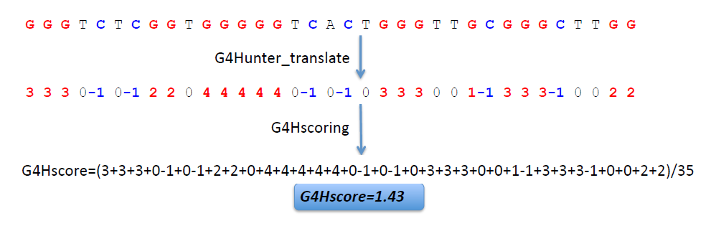
Algorithm

Slide 12
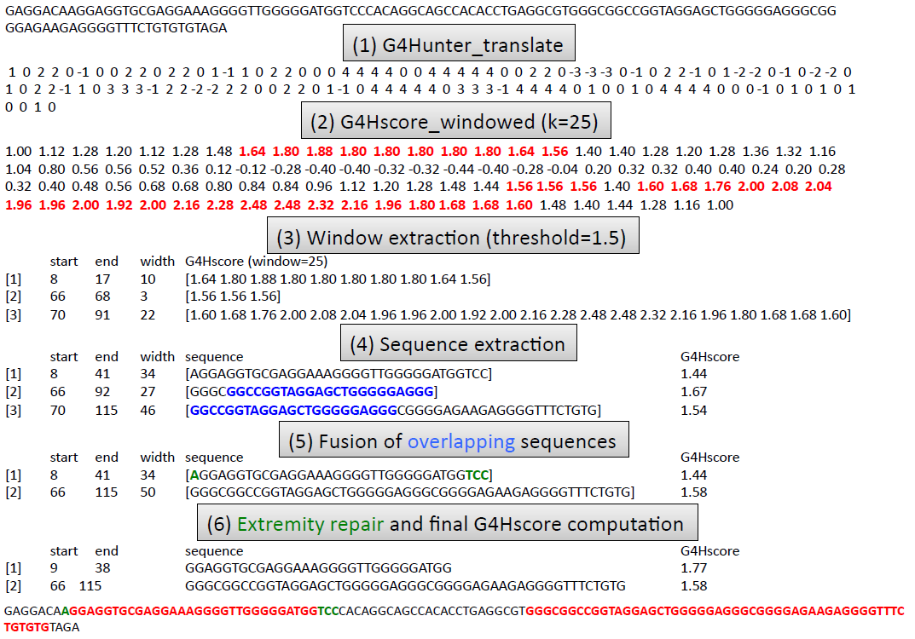
Algorithm

Slide 13
Objective
There has not been any published work that integrates this tool to identify overlaps of SNPs and G4-quadruplexes. Therefore, studies that aim to find associations between them are obliged to do so manually which can be very time-consuming for several reasons:
Finding the SNPs in the genomic file (exact distance).
Exploring a large range of predicted G4 sequences that is returned from G4Hunter to indicate which ones are close or overlap SNPs.
Repeating the steps for every SNP of a gene
This won’t be convenient for studies comprised of several genes and SNPs. Therefore, to resolve this issue this work provides a Python script that automatically maps the distances of SNPs of various genes to their closest or overlapping G4 sequences by integrating G4Hunter.

Slide 14
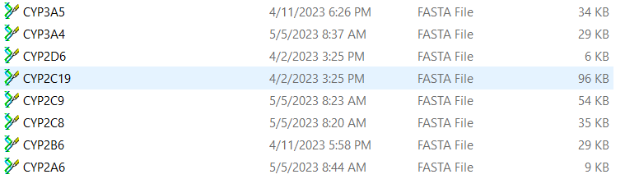
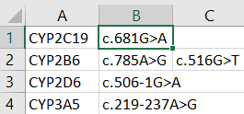
Procedure
FASTA files must include capital letters for bases at the exons and small letters for bases at the introns
The code takes 2 inputs

Slide 15

Procedure
Python program version 3.9.7 with the following libraries installed:
Biopython, matplotlib, and Numpy.
Once installed the code can be executed on the terminal by this command:
python new_code_g4_overlap.py
-i C:/Users/DELL/Desktop/cyp/test
-o C:/Users/DELL/Desktop/cyp/test_g
-w 25
-s 1.5

Slide 16
Workflow
The code first computes the distance of the SNPs to the genomic FASTA files relative to the start codon “ATG” for all genes.
The results are stored in a dictionary and then the G4Hunter tool will predict the g4 sequences for all the genes and write them down on a new text file located at the output repository provided by the user.
Then, the computes the distance of all G4 sequences relative to the start codon
Lastly, extracts the G4 sequence that either is adjacent to or overlaps a particular SNP for all the genes and their SNPs

Slide 17
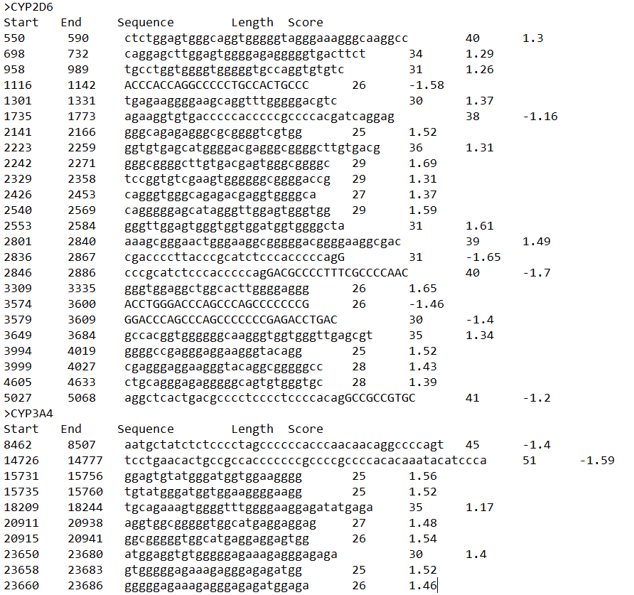
File written by G4Hunter

Slide 18
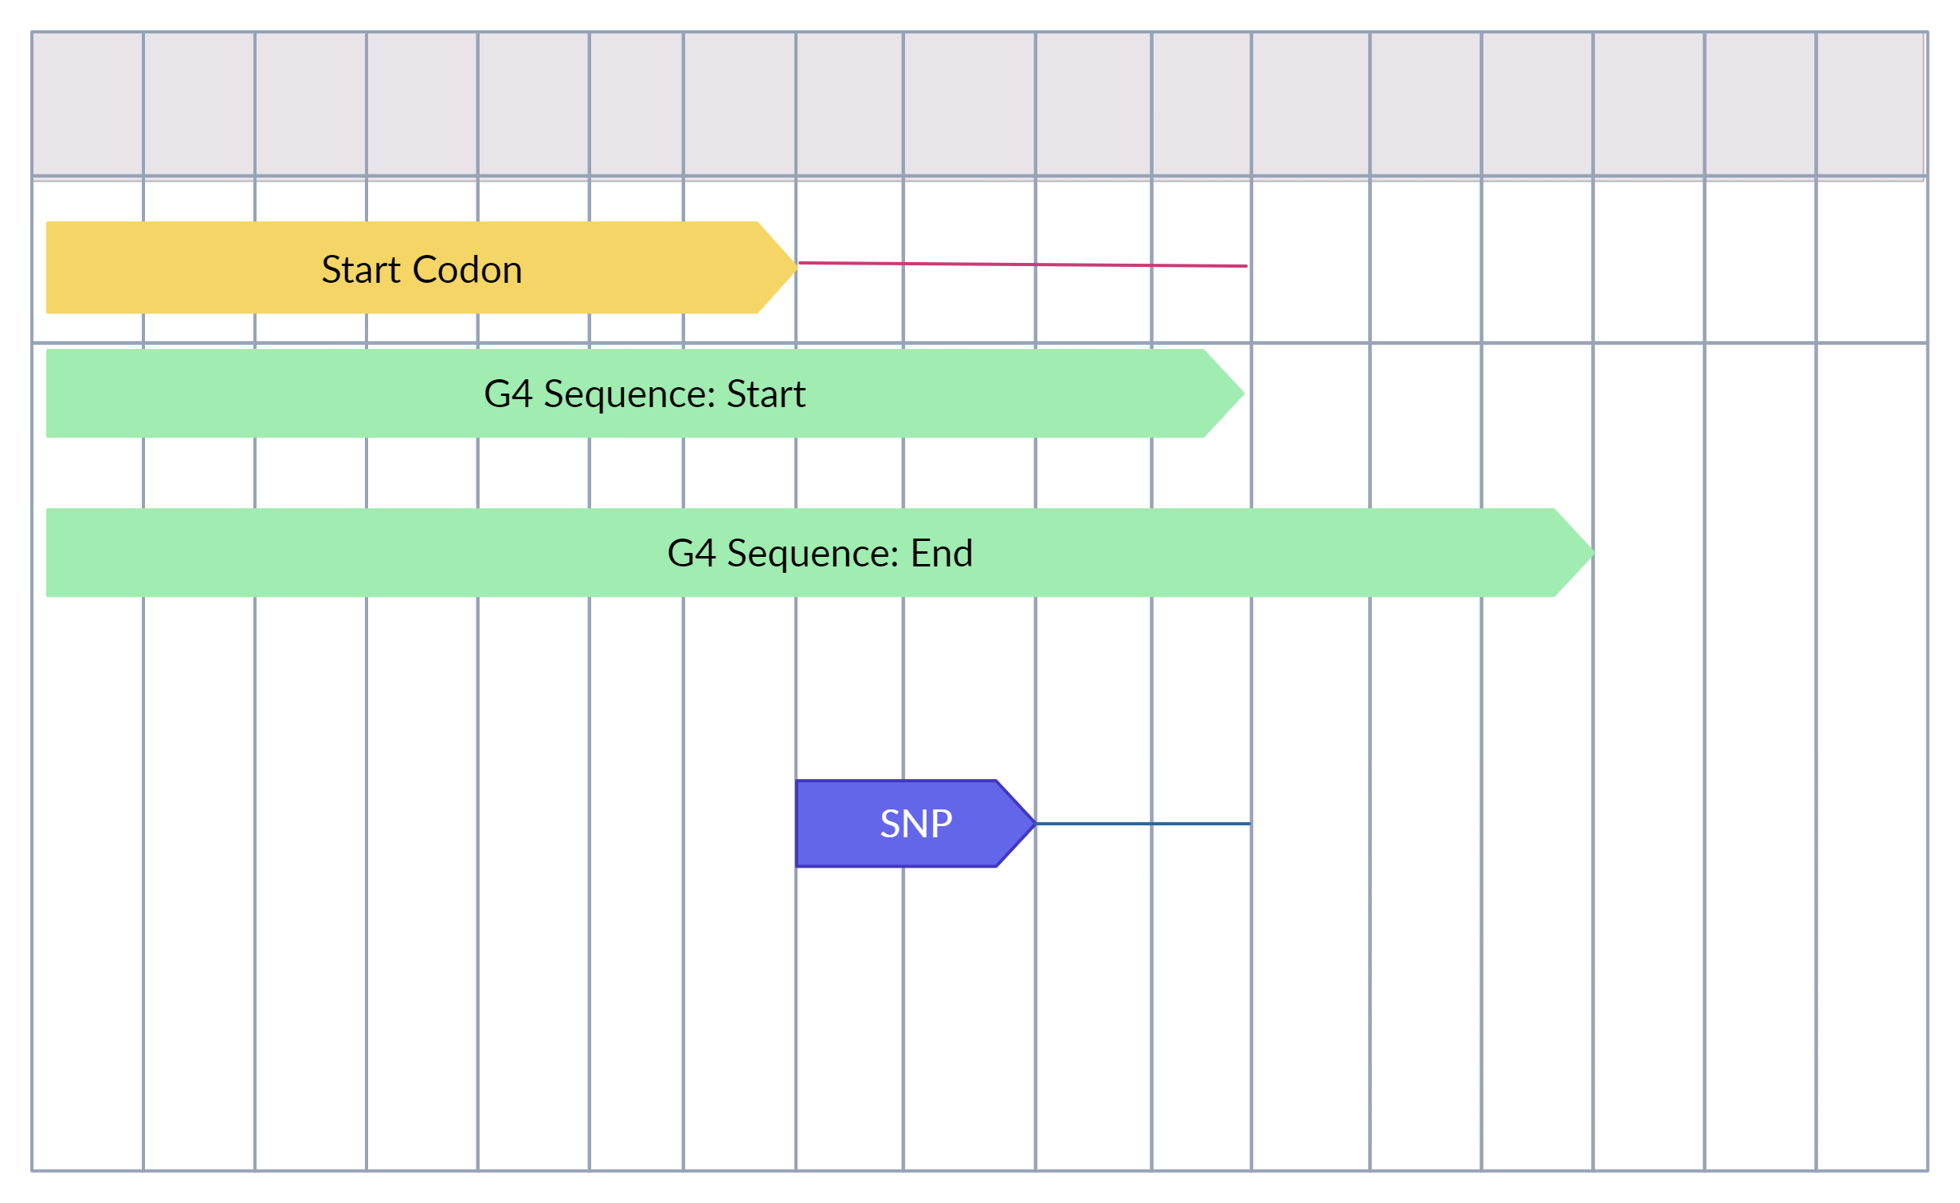
Computing the Distance

Slide 19
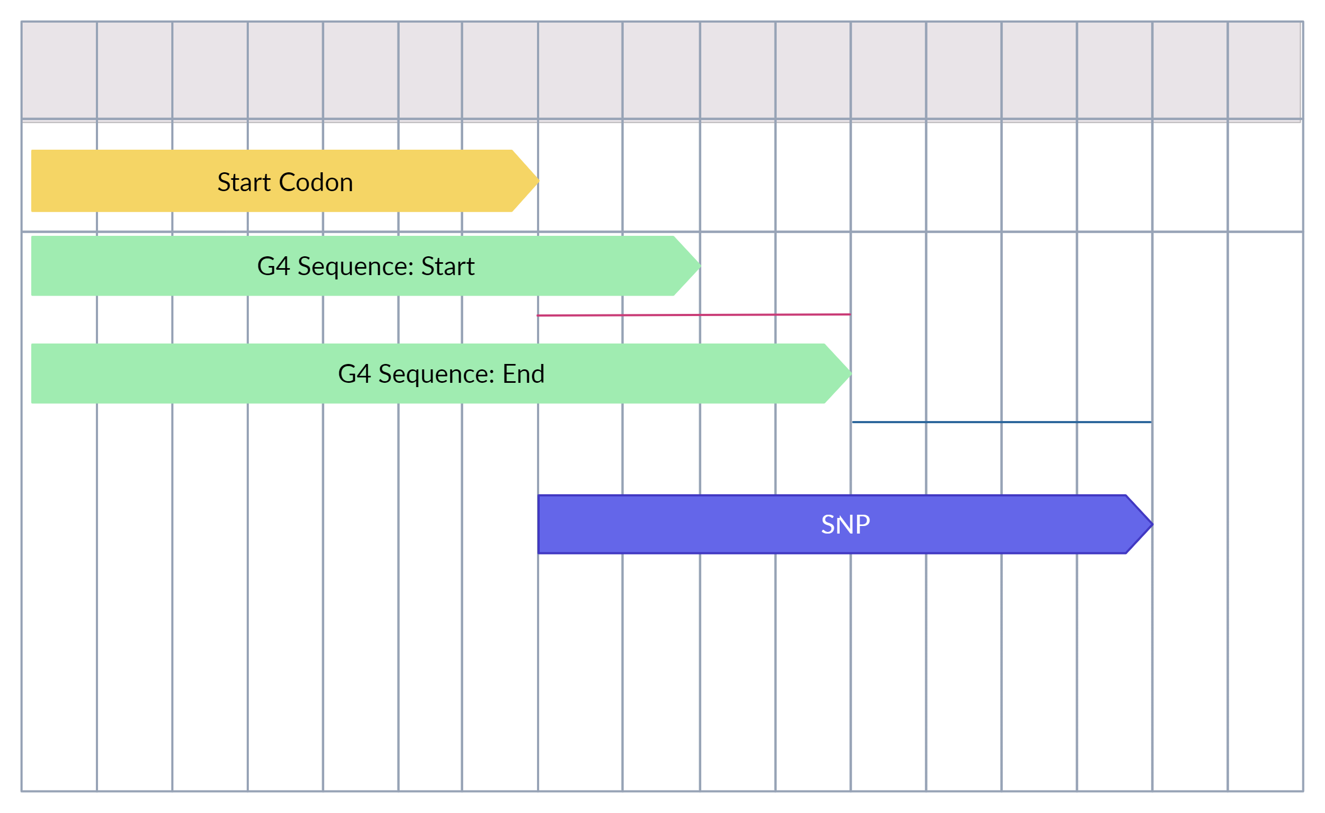
Computing the Distance

Slide 20
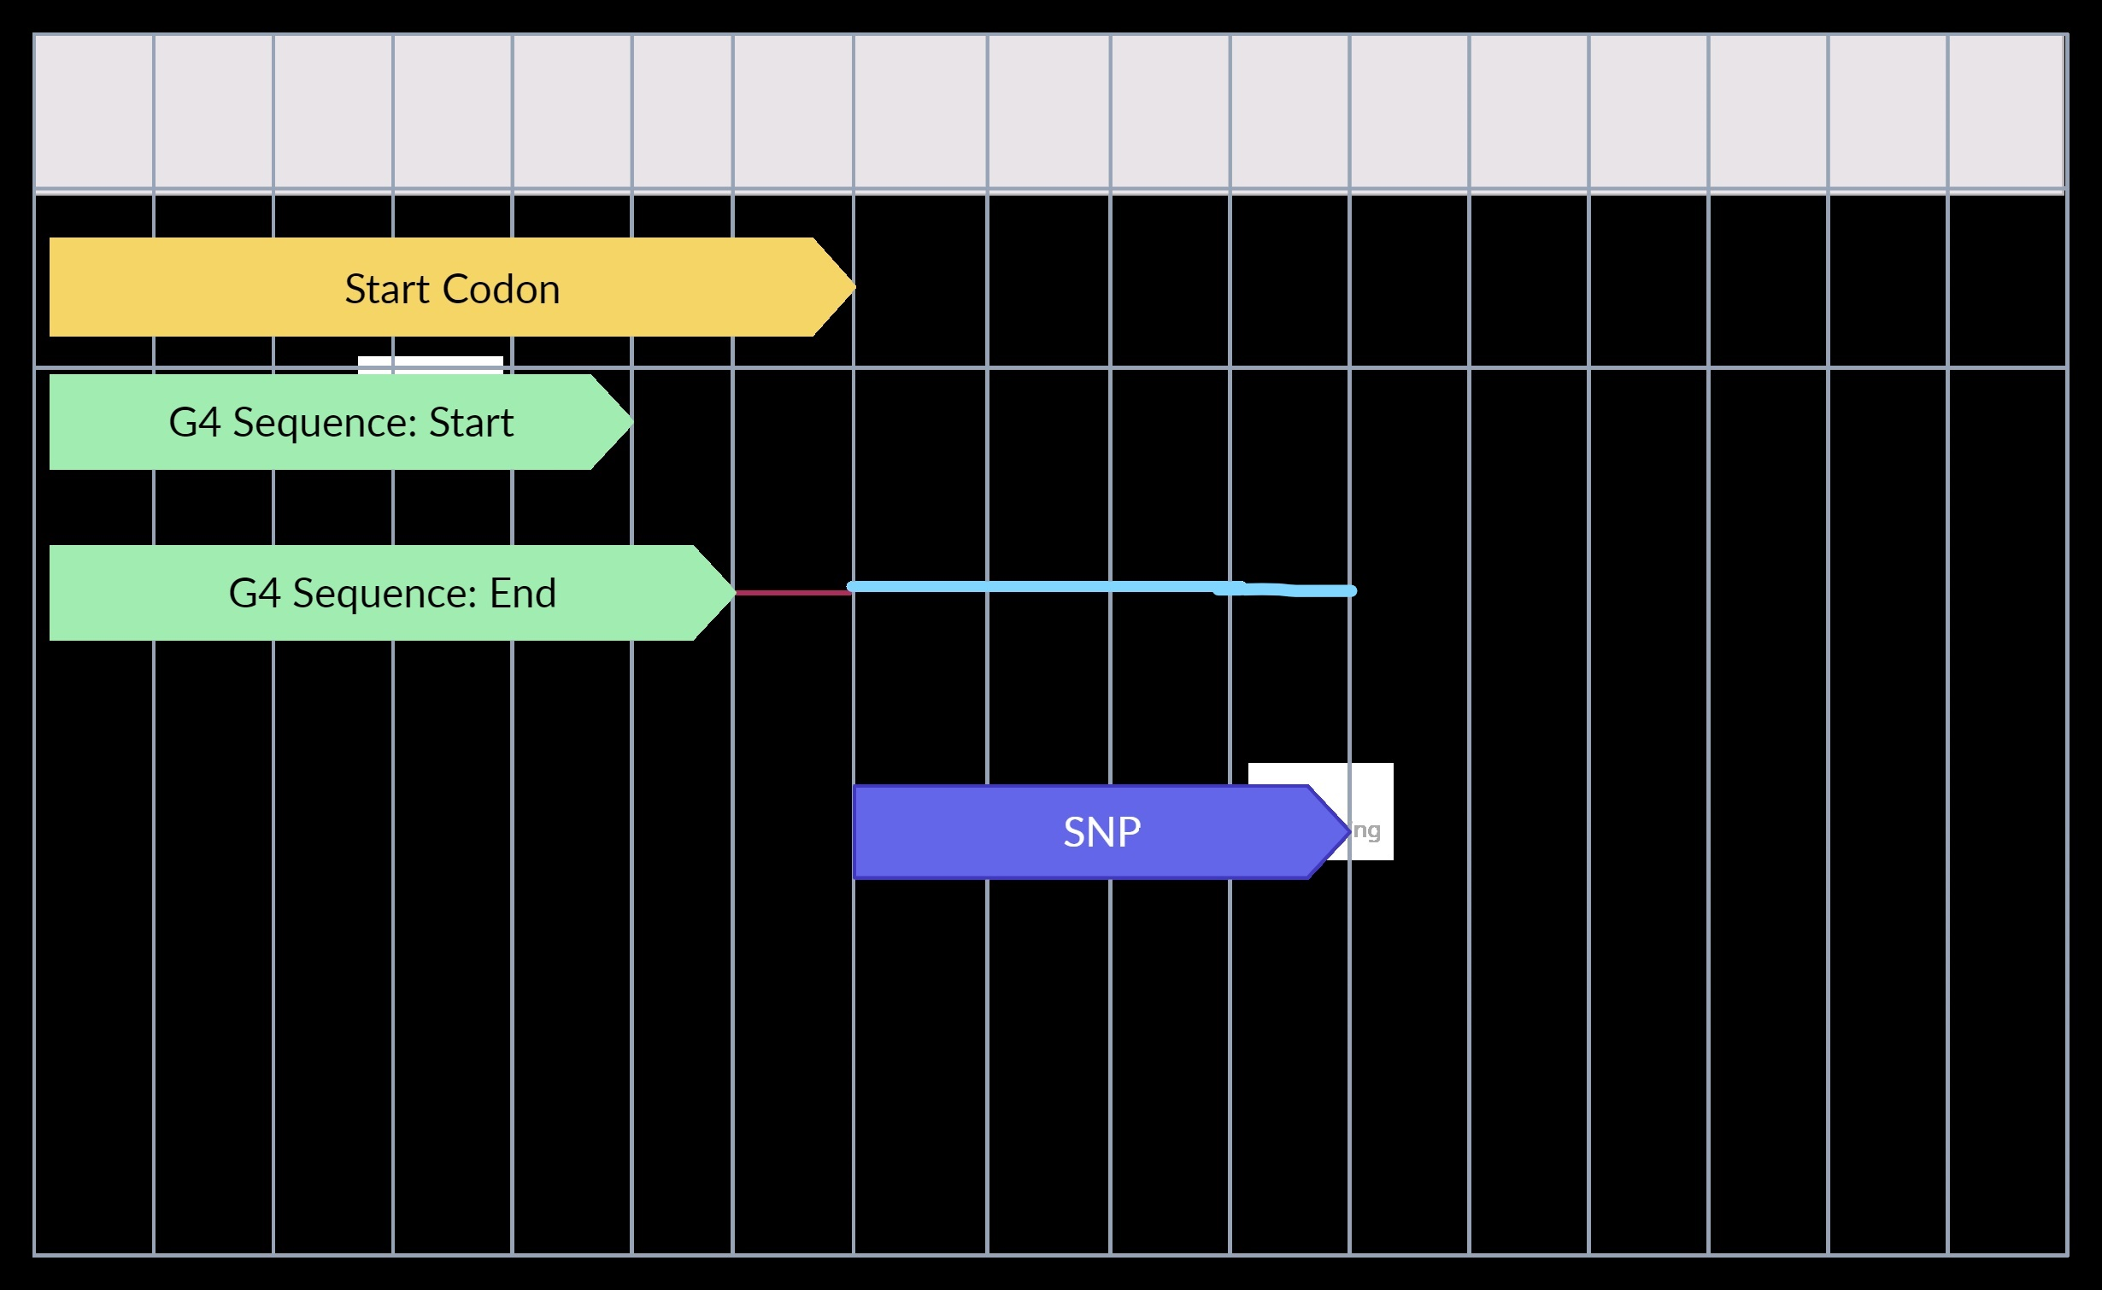
Computing the Distance

Slide 21
Gene | Start | End | Sequence | Length | Score | Distance from the SNP
ACTN4 | 63571 | 63600 | agtgacgcctccaccccccgccctactcg | 29 | -1.34 | 60
CYP2A6 | 2636 | 2662 | cccctgccgccccctggcctgtctcc | 26 | -1.62 | 62
CYP2B6 | 19050 | 19078 | TGAAACCCTGGACCCCAGCGCCCCCAAG | 28 | -1.36 | 0
CYP2C8 | 22992 | 3030 | agctttggtaactggggtgagggggatggaaaacagag | 38 | 1.18 | 195
CYP2C9 | 4390 | 4423 | tctgtcttggggatggggaggatggaaaacaga | 33 | 1.18 | 210
CYP2D6 | 2846 | 2886 | cccgcatctcccacccccagGACGCCCCTTTCGCCCCAAC | 40 | -1.7 | 0
ITGA3 | 21582 | 21607 | ccttcacacctccggccacccccca | 25 | -1.52 | 60
ITGB4 | 31779 | 31804 | GGGGCCGGCTGGGGGCCTGAGCGGG | 25 | 1.64 | 65
NPHS1 | 21551 | 21590 | tgagggaggtttgggggagactggtggcggggggcagca | 39 | 1.64 | 46
NPHS2 | 20210 | 20258 | tggcaggaacggtggggttggtggggatggacaggaggggttggtaca | 48 | 1.5 | 339

Slide 22
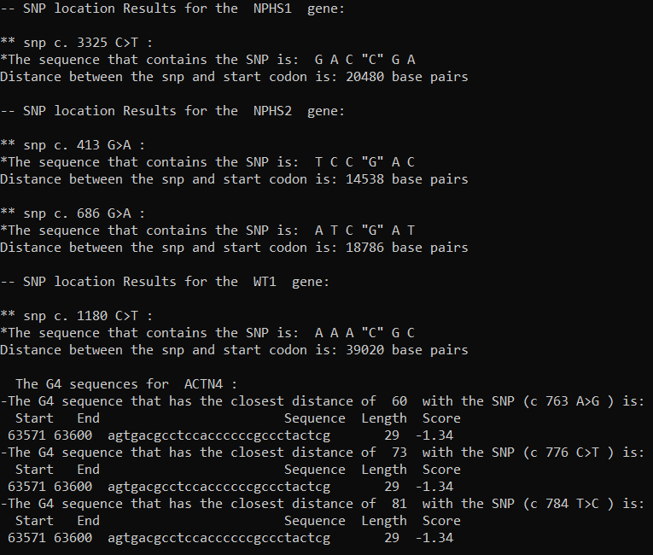

Slide 23
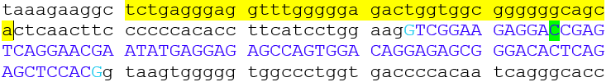

Slide 24
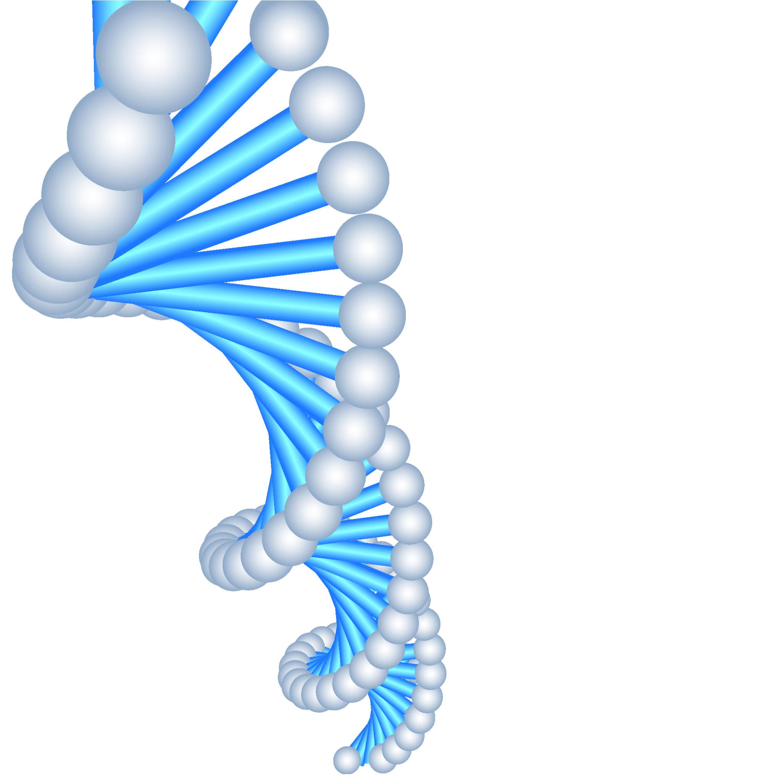
Future Studies
To draw conclusions and find patterns in the correlation of G4 sequences and SNPs, future studies can use this code on a large set of genes from various databases (UCSC Genome Browser) and analyse the results.

